Slide 1
Evolving Societies That
Work for Everyone
Anthony Biglan, Ph.D.
Senior Scientist
Oregon Research Institute
President,
Values to Action

Slide 2
Your values
If ten years from now, you looked back on 2020 and said, “things have really gotten better, what would be different?”

Slide 3
The Nurture Consilience
Paper should be available to you. Please don’t share it. It is under review.

Slide 4
According to E. O. Wilson, Consilience involves
The linking of facts and fact-based theory across disciplines to create a common groundwork of explanation.
Examples:
  Gravity
  Heliocentric theory
  Evolution
Related to Thomas Kuhn’s analysis of paradigms in his Structure of Scientific Revolutions

Slide 5
The Nurture Consilience
Diverse disciplines including biology, medicine, public health, social work, and social, clinical, and developmental psychology converge in identifying the environmental conditions that promote vs. undermine wellbeing.
I have found it useful to organize the evidence around the concept of nurturance.

Slide 6
Nurturing Environments
Minimize toxic biological and social conditions
Limit opportunities and influences for problem behavior
Richly reinforce diverse forms of prosocial behavior
Promote psychological flexibility: the mindful and pragmatic pursuit of one’s values, even in the context of troubling thoughts and feelings.

Slide 7
Toxic social conditions

Slide 8
Adverse Childhood Experiences--ACES
Physical abuse,
Verbal abuse,
Sexual abuse,
Physical neglect,
Emotional neglect.
An alcoholic parent
Abuse of one’s mother
Family member in jail,
Mentally ill family member
Loss of a parent through divorce, death or abandonment

Slide 9
As the number of ACEs increases so does the risk for the following:
Alcoholism
Chronic obstructive pulmonary disease
Depression
Fetal death
Health-related quality of life
Illicit drug use
Ischemic heart disease
Liver disease
Poor work performance
Intimate partner violence
Multiple sexual partners
Sexually transmitted disease Smoking
Suicide attempts
Unintended pregnancies
Early initiation of smoking
Early initiation of sexual activity
Adolescent pregnancy
Risk for sexual violence
Poor academic achievement
Source: CDC

Slide 10
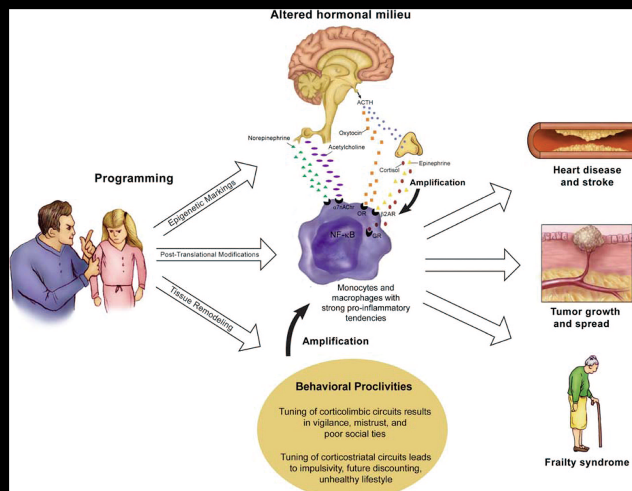
How Stress Gets Under the Skin
Miller paper—some detail his figure [from gunnar]

Slide 11
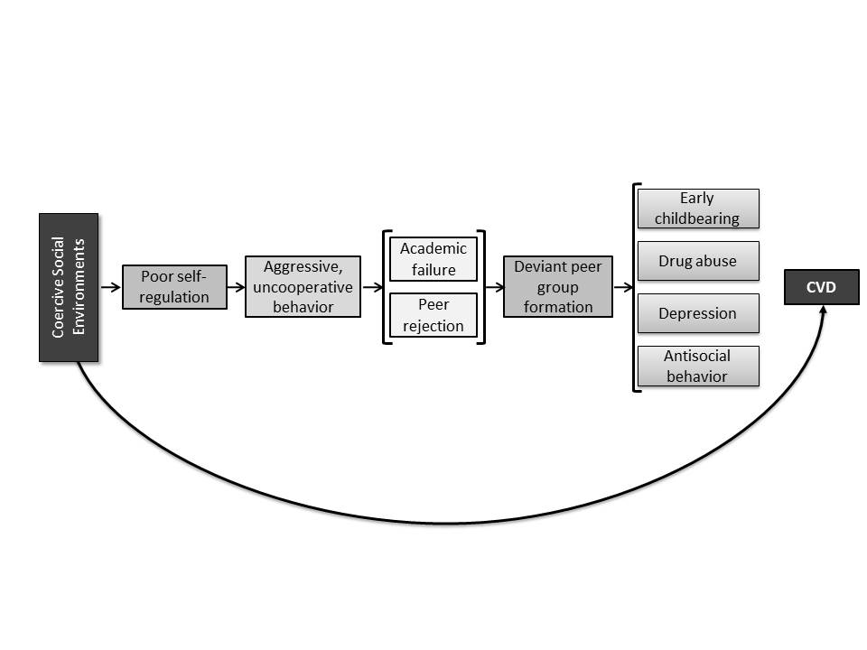
“Fast” Developmental Pathway
Poverty
Discrimination

Slide 12
Consistency of This View with Evolutionary Theory
The reaction to threatening environments is an evolved capacity that furthered survival in dangerous environments.
In a world where life might be cut short, the elicitation of a fast life strategy meant that you might pass on our genes.
In a dangerous world, you better have our babies early.
Such a strategy may favor effective reproduction, but, at the same time, it contributes to premature death.

Slide 13
On the Other Hand
The fact that humans evolved in ways that have taken over the world (for better and for worse) is the result of our evolved capacity to cooperate.
  This has depended on high levels of prosociality and the suppression of behavior that benefits the individual at the cost of the group.
    Control both through sanctions and reinforcement and through evolved cooperative capacities
Groups can also cooperate to harm other groups. Achieving cooperation at every level is vital.

Slide 14
Materialistic Values vs. Prosocial Values
Tim Kasser has described a constellation of attitudes, values, and behaviors he labels materialism.
People with materialistic values desire and seek wealth, possessions, image, and status.
They agree with statements like,
  “I like a lot of luxury in my life,”
  “I’d be happier if I could afford to buy more things,” and
  “The things I own say a lot about how well I’m doing in life.

Slide 15
People with this Constellation of Values
Are more likely to
  Think of themselves in negative terms
  Have problems with depression and anxiety
  Rate their physical health and life satisfaction more negatively.
  Engage in compulsive buying and risky health behaviors such as smoking.
  Act in self-serving ways
  Take advantage of others
As citizens, they are less likely to be egalitarian and more likely to hold prejudicial views toward people in other groups and to try to dominate others.
Couples that share materialistic values rate their relationships more negatively than other couples.

Slide 16
Why would people have these values?
Marketing
  Exposure to ads that promise to assuage our troubles has increased enormously since the advent of radio, TV, etc.
Threat
  Kasser has done some clever experiments that show that people are more likely to endorse materialistic values if you simply get them to think about threatening topics, like dying, having others snub them, or being poor.

Slide 17
The Power of Prevention

Slide 18
“The scientific foundation has been created for the nation to begin to create a society in which young people arrive at adulthood with the skills, interests, assets, and health habits needed to live healthy, happy, and productive lives in caring relationships with others.”

Slide 19
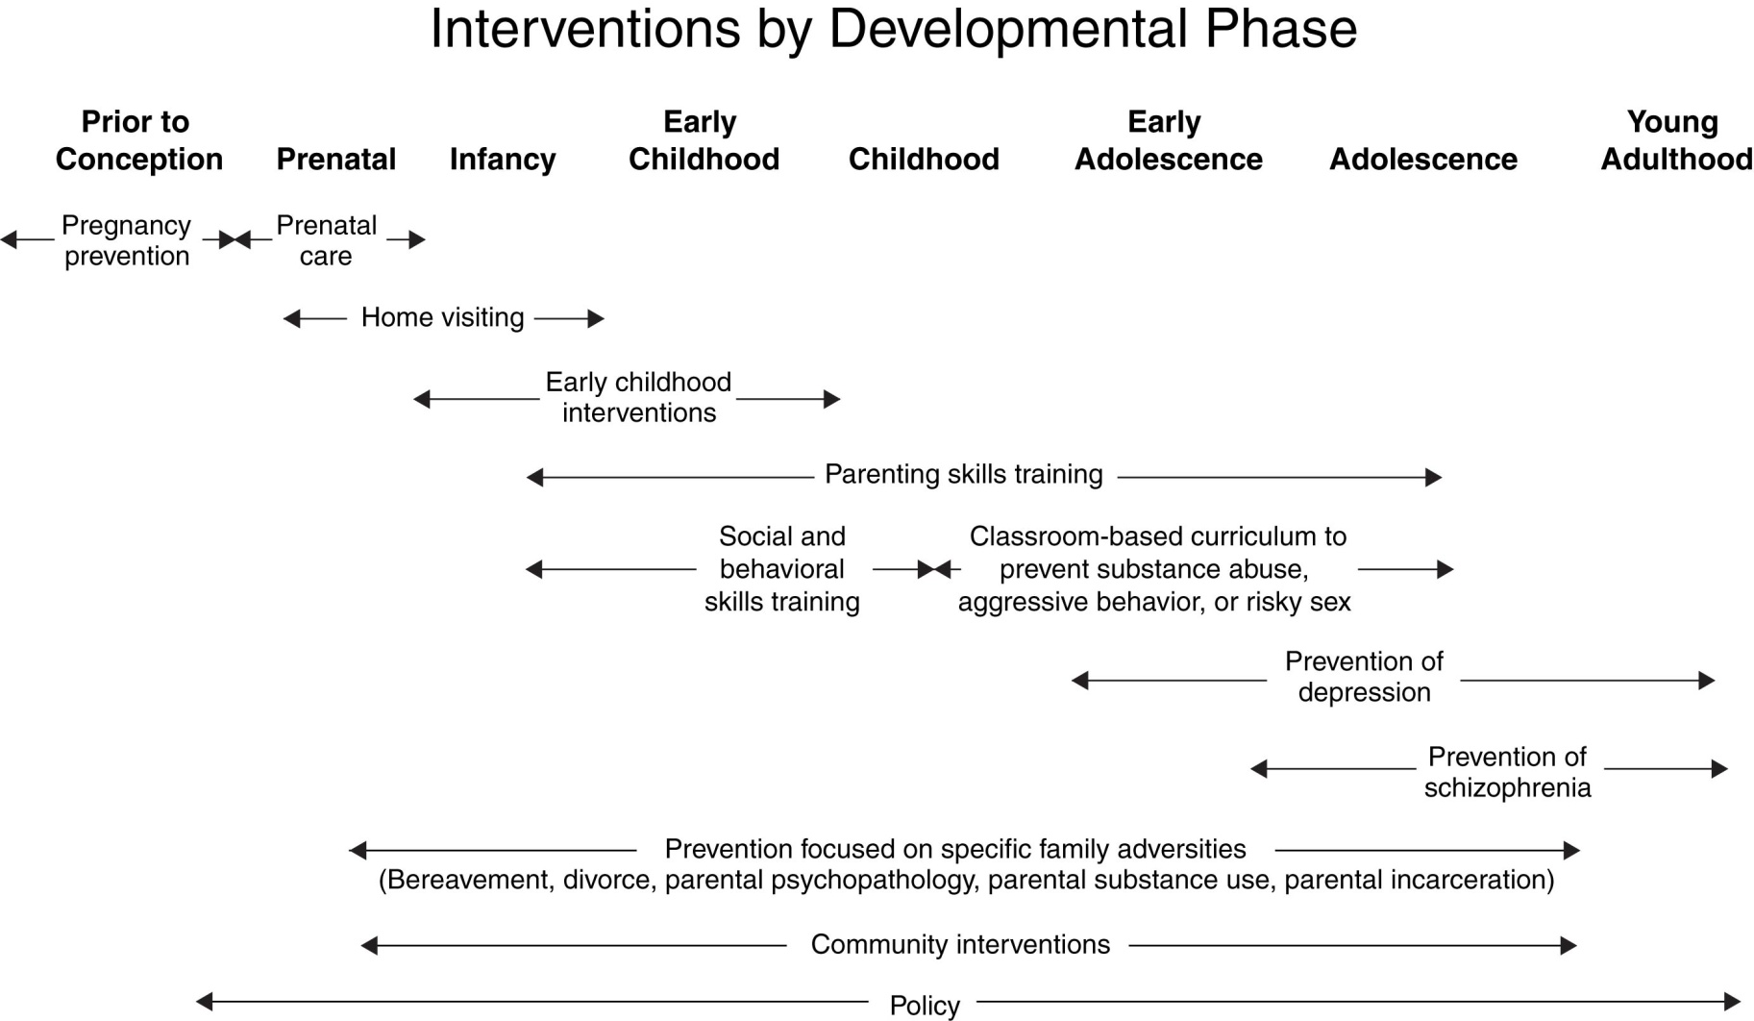
Notes:
This is a developmentally oriented diagram that shows how we might think about prevention. In the report in several major chapters, we document the evidence for these different kinds of interventions. Early in life: prenatal care, home visitation, high quality daycare have a very strong evidence base for preventing a variety of disorders later. Into childhood, we have general interventions like parent skills training that have a strong knowledge base and more specific interventions such as prevention of depression. Across the bottom of the diagram, there is a very strong evidence base for family adversity intervention. By community interventions, we should recognize that we mean not just ways to strengthen communities but also addressing poverty, addressing violence, and addressing social isolation and also that policy is absolutely key.
Multiple opportunities for intervention across young people’s developmental course
In some cases, specific interventions are ties to a particular developmental stage given the emergence of symptoms and disorders at that stage (e.g., substance abuse, depression), but earlier interventions can lay the foundation for success
Ideally, a given intervention would not be delivered in isolation but within a broader network of a community system of supports.

Slide 20
Evidence-Based Family
Interventions through the Lifespan
Leslie et al., 2016
Program (Target age) | Impact
Family Foundations (0-2) | Antisocial-aggressive Behavior, Anxiety, Conduct Problems, Depression, Externalizing, Internalizing, Prosocial with Peers
Nurse-Family Partnership (0-2) | Child Maltreatment, Delinquency and Criminal Behavior, Early Cognitive Development, Internalizing, Mental Health - Other, Physical Health and Well-Being, Preschool Communication/Language Development, Reciprocal Parent-Child Warmth
Family Check-up (Toddler Version; 0-2) | Conduct Problems, Externalizing, Internalizing, Reciprocal Parent-Child Warmth
Triple P System (0-11) | Child Maltreatment, Mental Health – Other
Incredible Years – Parent (3-11) | Antisocial-aggressive Behavior, Close Relationships with Parents, Conduct Problems, Depression, Externalizing, Internalizing, Positive Social/Prosocial Behavior
Parent Management Training – Oregon Model (3-18) | Antisocial-aggressive Behavior, Conduct Problems, Delinquency and Criminal Behavior, Externalizing, Internalizing
Parent-Child Interaction Therapy (PCIT; 3-11) | Antisocial-aggressive Behavior, Child Maltreatment, Conduct Problems
New Beginnings (For children of divorce; 5-18) | Antisocial-aggressive Behavior, Close Relationships with Parents, Externalizing, Internalizing, Mental Health - Other, Reciprocal Parent-Child Warmth, Sexual Risk Behaviors

Slide 21
Schools
E-Circle Professional Development for Preschool Providers
Positive Behavioral Intervention and Support
Promoting Alternative Thinking Strategies—PATHS
Positive Action
The Good Behavior Game
Cooperative Learning
Meaningful Roles

Slide 22

Timeline of benefits
First Month
More time for teaching and learning
Less stress for staff and students
First Year
Better attendance
Fewer referrals
Fewer service needs
Less illness
Happier families
Less vandalism
Better academics
Two-three years
ADHD averted
Oppositional Defiance averted
Special education averted
5-15 years years
No tobacco
Less alcohol
Fewer conduct disorders
Less depression
Less crime, violence, suicide
High school graduation & university

Slide 23
However, simply widely implementing nurturing programs is not enough, if our societies continue to harm millions.

Slide 24
We need to understand how capitalism took us where we didn’t want to go.
The Rise of the Conservative Billionaire Coalition

Slide 25
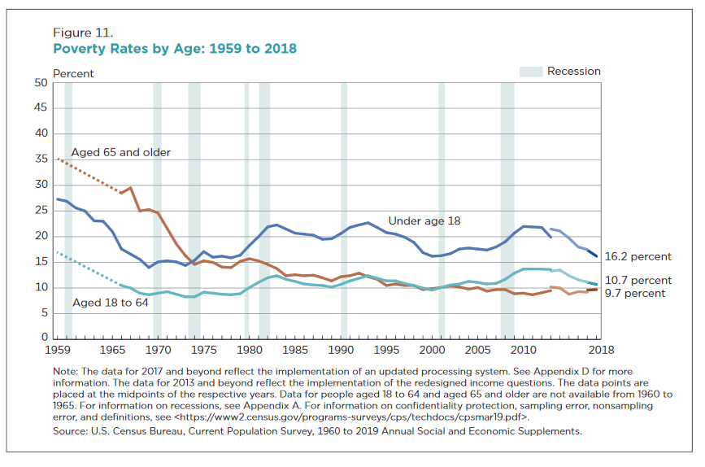

Slide 26
Source: Children’s Defense Fund

Slide 27
Health and social problems are closely related to inequality in rich countries³⁸
Worse
* USA
Portugal *
Index of health and social problems
UK *
Greece *
* New Zealand
Austria *
Ireland *
France *
Australia *
Germany *
* Canada
Italy *
Denmark *
*
Belgium
* Spain
Finland *
*
Netherlands
* Switzerland
Norway *
* Sweden
Better
* Japan
Low
Income Inequality
High

Slide 28
Robert Putnam’s Our Kids
Over the past fifty years, America has become far less nurturing of those who are poorer.
Economic inequality and poverty have increased greatly
Social Mobility—the chance that a poor child will move out of poverty—has virtually disappeared.

Slide 29
A Brief History of the Evolution of Capitalism in the U.S.
The Status of Business in 1970.
The Lewis Powell memo:
  …independent and uncoordinated activity by individual corporations, as important as this is, will not be sufficient. Strength lies in organization, in careful long-range planning and implementation, in consistency of action over an indefinite period of years, in the scale of financing available only through joint effort, and in the political power available only through united action and national organizations .
A unifying theme: A clear, cogent, and, to some extent, empirically supported theory of economics:
  The individual pursuit of economic gain will necessarily benefit the society
The forging of a large network of organizations
A resulting diminution of our communitarian values
*https://evolution-institute.org/article/evolving-a-more-nurturing-capitalism-a-new-powell-memo/?source=tvol

Slide 30
The Conservative Billionaire Coalition
Huge, well funded, and coordinated.
Free market economic theory is the intellectual framework that has guided and coordinated efforts.
    The invisible hand
    Government is harmful and incompetent
    People are inherently selfish maximizers
    When we let people and organizations pursue their own economic wellbeing in the market place, it will necessarily benefit everyone.
    Unregulated markets are the most efficient way to promote freedom and prosperity.

Slide 31
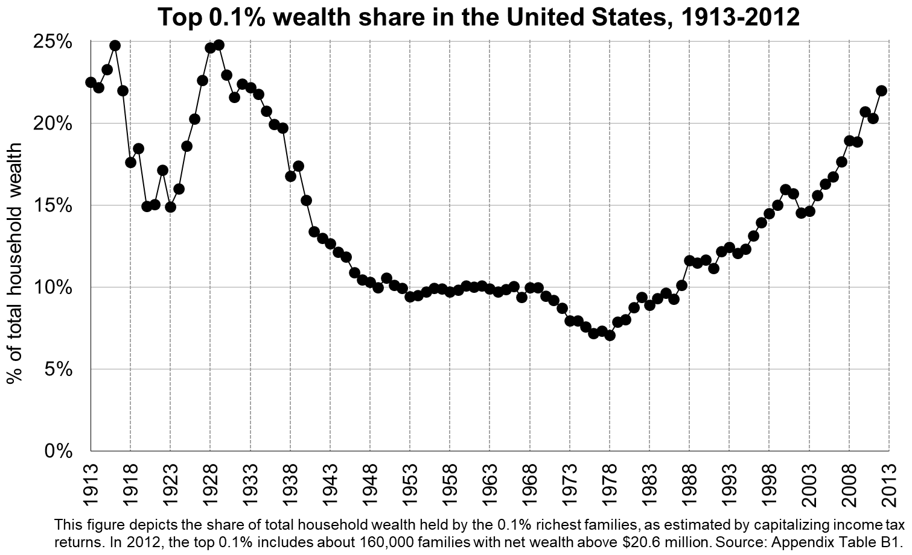
The Consequence That Selected Conservative Advocacy
Top 0.1% wealth share in the United States, 1913-2012²³

Slide 32
How the Nurture Consilience Can Guide the Evolution of a More Nurturing Form of Capitalism
Start by creating an unprecedented coalition.

Slide 33
A coalition
Among all of the disparate groups that are working to improve wellbeing in one area or another
  Tobacco use
  Pharmaceutical corruption
  Guns
  Fossil fuels
  Poverty
  Discrimination
  Our punitive criminal justice system
  Climate change
  Covid-19
  Domestic Violence

Slide 34
Currently, unlike the CBC, those working to promote nurturance are uncoordinated.
Huge number of organizations working to advance nurturance--prosocial values, norms, and behaviors.
Human Sciences (e.g., Coalition of Behavioral Science Organizations)
Foundations
Advocacy organizations (tobacco, alcohol, drug abuse, gun control, unhealthful food marketing, fossil fuel marketing, child wellbeing, etc.)
Public Health
Political parties
Religious organizations
Business reform movements (Conscious Capitalism; B corps)
Criminal Justice Reform organizations
Media Reform

Slide 35
The Nurture Consilience
Can provide the framework for organizing the selection of nurturing practices at every level up to that of worldwide cooperation.
The situation we now face is that we have numerous disparate and uncoordinated organizations working to address one or another of our many problems.
We need to create a coalition of all the organizations that are committed to evolving societies that promote everyone’s wellbeing.
It needs to be as large, coordinated, and sophisticated as the Conservative Billionaire Coalition.
And it needs to work over an indefinite period of time.

Slide 36
Two Key Principles
Public Health and Community Organizing

Slide 37
Public Health
Any aspect of human wellbeing can be examined in terms of it impact on the incidence and prevalence of that aspect in a population.
  Covid-19 infections
  Cigarette smoking
  Depression
  Kindness
  Economic wellbeing
  Greenhouse gas emissions
Relevant from the level of a neighborhood to the level of a state, the nation, or the entire world.

Slide 38
Community Organizing
It is a matter of bringing every sector of a community (or a state, a nation, or the entire world) together around the goal of improving the wellbeing of the population.
Organize the sectors from most likely to be supportive to least likely to be supportive.
Identify evidence-based policies and programs that have the potential to affect the targeted outcome.
Implement, evaluate, refine your strategies.

Slide 39
Which Brings Us to Rebooting Capitalism
Foreword by David Sloan Wilson
Introduction
One: Selection by Consequences
Two: Your Readiness for Advancing a Nurturing Society
Three: A Framework for Making Our Society More Nurturing
Four: The Values to Action Coalition: The Foundation for the Change We Seek
Five: Businesses That Nurture

Slide 40
Rebooting Capitalism
Six: Nurturing the Health of Every Person
Seven: Higher Education: The Incubator of a New Society
Eight: Reforming Criminal Justice
Nine: Evolving Social and News Media to Promote Prosocial Values
Ten: Climate Change
Eleven: A Political System That Works for All
Conclusion

Slide 41
Principles for Societal Reform
You can choose to embrace the value of having a society that is organized around ensuring the wellbeing of every person.
If you do, you will want every sector of society to minimize individual behavior and corporate/organizational behavior that harms members of the population and promote practices that benefit people.
Practices are selected by their consequences.
  The tobacco industry
  The cell phone industry

Slide 42
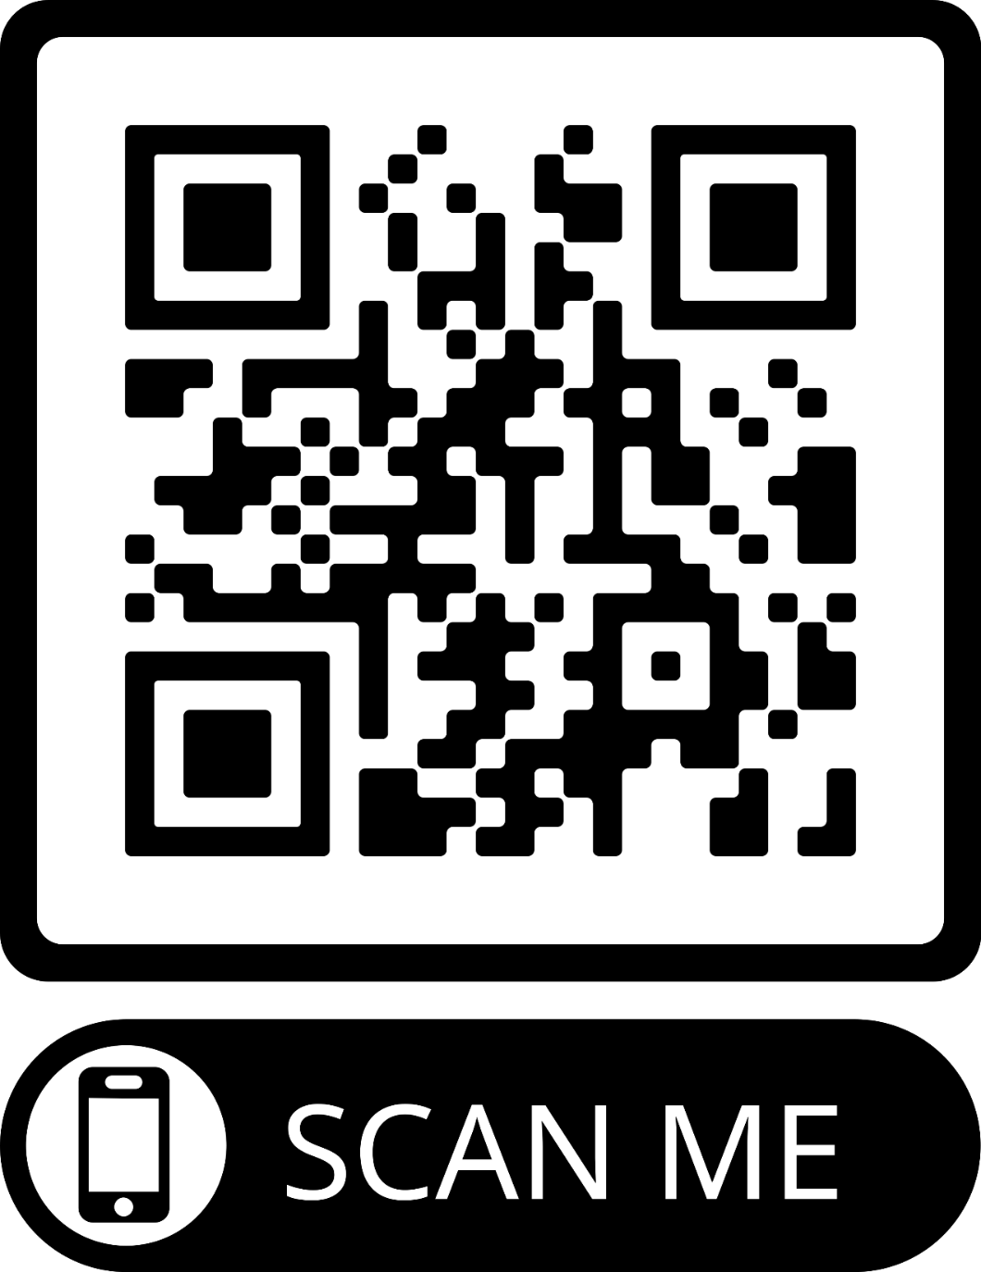
https://valuestoaction.com/reboot/

Slide 43
Examples of Reform in
Major Sectors of Society

Slide 44
Business
Traditional narrow focus on benefit to investors
Reformed focus:
  Impact of practices on employees, customers, suppliers, investors, and the community/society as a whole.

Slide 45
Healthcare—Actually Public Health
Traditional focus:
  Treating people once they are ill
  Maximizing the revenue of pharma, insurance companies, and providers
Reformed (Public Health) Focus:
  Practices are selected on the basis of the impact on the health of the population.
  A much greater proportion of health care spending would be spent on prevention

Slide 46
Criminal Justice
Currently
  The most punitive system in the world from policing to imprisonment
Reform:
  Goals are the prevention of crime and the reduction in recidivism and the elimination of police brutality.
  Select all practices on the basis of their measurable impact on these outcomes.

Slide 47
Social and Mass Media
Social media promised us increased participation in democratic processes.
But the internet has selected racist and hateful speech and behavior.
Reform would evolve social media to promote prosocial values and behavior.

Slide 48
Climate Change
Virtually no contextual behavioral science research on reducing greenhouse gas emissions.

Slide 49
Politics
Currently our political system is under the control free market advocates.
Reforms that are needed:
  Restrictions on money in politics
    Overturn Citizens United
    Publicly funded campaigns.
These reforms will not be possible, unless we convince millions of people that free market ideology took us where we didn’t want to go. We need to make the wellbeing of the population the touchstone of our political system.

Slide 50
But Let’s Focus on Higher Education

Slide 51
Higher Education
Current Focus:
  Maximizing grant funding
  Maximizing endowment
  Maximizing revenue from sports
  Maximizing administrators salaries
  Putting students into debt
Reform:
  Systematic analysis of the degree to which all of the activities of universities are enhancing vs. undermining population wellbeing.
    Business schools
    Law schools
    Behavioral Science
      Research on affecting our major problems?
      Training the people needed to prevent problems and promote wellbeing

Slide 52
Examples regarding Higher Education
Analysis of the behavioral science research and training in the top 100 Universities in the U.S.
  Psychology
  Education
  Political Science
  Sociology
  Social Work
  Economics
  Public health
  What else?
To what extent is it contextualist in the sense that it
  Focuses on identifying malleable influences on important social problems and
  Experimentally evaluates strategies for affecting the incidence and prevalence of problematic behaviors and organizational practices or incidence and prevalence of beneficial behaviors and practices

Slide 53
Choosing Something to Work on
If you chose to spend 15 minutes a day working to reform any aspect of your society, community, or organization, what would you choose to work on?

Slide 54
The Theory of Values to Action
It is just a theory! Criticize it to make it more effective.

Slide 55
Create teams of people who join Values to Action to work for the reforms called for in Rebooting Capitalism.
Reforming the Criminal Justice System.
Reducing Disparities in Health.
Reforming Business So It Works for Everyone.
Reforming Higher Education.
Using Social Media to Promote a More Nurturing Society.
Reducing Greenhouse Gas Emissions.
Promoting Rebooting Capitalism.
Promoting Psychological Flexibility
Reducing Greenhouse Gas Emissions
Advancing the Nation’s Efforts to Reduce Concentrated Disadvantage
Improving Child and Adolescent Wellbeing in Your Community
Building A Coalition of Reform Organizations

Slide 56
Based on a survey of those who join…
Start by forming teams to work on the topics that joiners want to make a priority.
This idea is, in part, based on experience of Coalition of Behavioral Science Organizations and the two task forces it created.

Slide 57
Strengthening Families Task Force
Wrote a Paper summarizing the policies and programs that are needed to increase the prevalence of nurturing families.
Meeting on Concentrated Disadvantage
Gathering support for a long term effort to reduce concentrated disadvantage.

Slide 58
Climate Change Task Force
Systematic Review of the Literature on Reducing Greenhouse Gas Emissions.
Paper on research on community interventions.
Paper on federal funding
Paper on research on getting policies adopted.
How much behavioral science research in included in the Green New Deal?

Slide 59
Polling
Your values—if ten years from now you looked back on 2020 and said, things have really gotten better, what would be different?
Read the book?
Complete the survey
Joining a team
  How interested would you be in joining one?
  How many hours a week would you be willing to volunteer?
  What would you want to work on.
Take one of the areas of reform and brainstorm team work that could advance the reform:
  Must require no more than two hours a week for no more than ten weeks.

Slide 60
Critique of this theory

